Slide 1
Anti-Patterns
Phil Pfeiffer
April 2015
Source: AntiPatterns: Refactoring Software, Architectures, and Projects in Crisis, Brown, Malveau, McCormick III, and Mowbray

Slide 2
AntiPatterns
Canonical descriptions of common strategies for undoing actions with bad consequences.
Purpose
  Help identify problems
  Help implement solutions
Root causes
  Haste - typically, shortcutting architecture and testing
  Apathy - typically, neglecting proper partitioning
  Narrow-mindedness - e.g., failure to build metadata into systems
  Sloth - e.g., lack of configuration control
  Avarice - wanting too much from too little resources
  Ignorance - insufficient generality, yielding brittle systems
  Pride - "not invented here"-based resistance to reuse, other ideas

Slide 3
Brown et al.'s Three Categories
Software Development Anti-Patterns
Software Architecture Anti-Patterns
Software Project Mgmt. Anti-Patterns

Slide 4
Development:
Blob Objects
Main Controller Class
Start
Stop
Initialize
Set_Mode
Login
Set_Status
Begin_Review_A
Refresh_Console
Do_This
Do_That
Do_The_Other
Etc.________________________________
Data_List_Pointer
Status
Mode
User
Group
Date_Time
ACL
Module_Button_1, _2, _3
Iterator_1, _2
Console
Etc.
Traits
  Single class with large number of objects, attributes, or both
  Lack of cohesiveness
  Too complex for reuse and testing
Causes
  Absence of OO architecture
  Absence of any architecture
  Lazy addition of functionality
  Bad requirements
Fixes?

Slide 5
Development:
Blob Objects
Main Controller Class
Start
Stop
Initialize
Set_Mode
Login
Set_Status
Begin_Review_A
Refresh_Console
Do_This
Do_That
Do_The_Other
Etc.________________________________
Data_List_Pointer
Status
Mode
User
Group
Date_Time
ACL
Module_Button_1, _2, _3
Iterator_1, _2
Console
Etc.
Traits
  Single class with large number of objects, attributes, or both
  Lack of cohesiveness
  Too complex for reuse and testing
Causes
  Absence of OO architecture
  Absence of any architecture
  Lazy addition of functionality
  Bad requirements
Fixes
  Redesign; partition

Slide 6
Planned Obsolescence
Example:
  DDE
  OLE 1.0
  OLE 2.0
  COM
  ActiveX
  DCOM
  COM+
  .NET 1.0, 2.0, 3.0, 4.0, 4.5, 5.0
Fixes?

Slide 7
Planned Obsolescence
Example:
  DDE
  OLE 1.0
  OLE 2.0
  COM
  ActiveX
  DCOM
  COM+
  .NET 1.0, 2.0, 3.0, 4.0, 4.5, 5.0
Fixes: use of stable standards

Slide 8
Lava Flow
// This class was written by someone (Alex?) to manage indexing or
// something. It's probably important. Don't delete it. It might not be used
// anywhere – at least not in the new MacroIndexer module that might
// actually replace it
….
Causes
  Lack of proper configuration management
  Single-developer (lone wolf) code
  Lack of architecture
  Scrap and rework without code cleanup
  Architectural "scars"
Fixes?
Traits
  Frequent unjustifiable variables
  Undocumented, important looking functions that don't clearly relate to other components
  Loose, evolving architecture
  Blocks of commented-out code without explanation
  Dead code; inexplicable interfaces

Slide 9
Lava Flow
// This class was written by someone (Alex?) to manage indexing or
// something. It's probably important. Don't delete it. It might not be used
// anywhere – at least not in the new MacroIndexer module that might
// actually replace it
….
Causes
  Lack of proper configuration management
  Single-developer (lone wolf) code
  Lack of architecture
  Scrap and rework without code cleanup
  Architectural "scars"
Fixes:
  prevention, through architecture-driven development
  after the fact: reverse-engineer an architecture; reengineer
Traits
  Frequent unjustifiable variables
  Undocumented, important looking functions that don't clearly relate to other components
  Loose, evolving architecture
  Blocks of commented-out code without explanation
  Dead code; inexplicable interfaces

Slide 10
Functional Decomposition
Change_financial_status
Add_customer
Update_address
Calculate_loan
Calculate_interest
Calculate_payment_schedule
Alter_payment_schedule
Traits
  "Classes" with verb+noun names
  Classes with a single action
  No leveraging of inheritance and polymorphism
Causes
  Absence of OO architecture
  Bad specifications
Fixes?

Slide 11
Functional Decomposition
Change_financial_status
Add_customer
Update_address
Calculate_loan
Calculate_interest
Calculate_payment_schedule
Alter_payment_schedule
Customer
Change_financial_status
Add_customer
Update_address
Loan
Calculate_loan
Calculate_interest
Payment
Calculate_payment_schedule
Alter_payment_schedule
Traits
  "Classes" with verb+noun names
  Classes with a single action
  No leveraging of inheritance and polymorphism
Causes
  Absence of OO architecture
  Bad specifications
Fixes
  Redesign with classes

Slide 12
Poltergeists
Traits
  Classes with brief useful lifetimes whose associations duplicate those of other classes: e.g.: single-operation classes that
    initialize other classes, then are no longer used
    invoke other classes, then are no longer used
    have functional names, like "start_process_alpha"
Causes
  Lack of an OO architecture
  "Seat of the pants" object design
Fixes?

Slide 13
Poltergeists
Traits
  Classes with brief useful lifetimes whose associations duplicate those of other classes: e.g.: single-operation classes that
    initialize other classes, then are no longer used
    invoke other classes, then are no longer used
    have functional names, like "start_process_alpha"
Causes
  Lack of an OO architecture
  "Seat of the pants" object design
Fixes
  Fold code into the classes that they help to manage

Slide 14
Golden Hammer
When your only tool is a hammer, everything else is a nail.
Traits
  Use of identical tools and components for multiple, diverse ends
  Codes with bad performance, scalability, maintainability…
  Architectures mirror components
  Components dictate development
Causes
  Organization fixation on specific products due to past successes, large investments, isolation from current practice, reliance on proprietary technologies …
  Organizational politics
Fixes?

Slide 15
Golden Hammer
When your only tool is a hammer, everything else is a nail.
Traits
  Use of identical tools and components for multiple, diverse ends
  Codes with bad performance, scalability, maintainability…
  Architectures mirror components
  Components dictate development
Causes
  Organization fixation on specific products due to past successes, large investments, isolation from current practice, reliance on proprietary technologies …
  Organizational politics
Fixes:
  Organizational culture change .. and learning

Slide 16
Dead End
Traits
  Customizing COTS code, resulting in incompatibility with later release
Causes
  Workaround for vendor product limitation
Fixes?

Slide 17
Dead End
Traits
  Customizing COTS code, resulting in incompatibility with later release
Causes
  Workaround for vendor product limitation
Fixes:
  Avoid
  Put isolation layer between COTS code, modification

Slide 18
Spaghetti Code
Traits
  Unstructured, procedural logic with poor reusability
  Minimal relationships between objects (if present)
  RTTI
  Minimal, if any, use of polymorphism and inheritance
Causes
  Inexperience
  No mentoring; ineffective code review
  Implementation without prior design
  Developers working in isolation
Fixes?

Slide 19
Spaghetti Code
Traits
  Unstructured, procedural logic with poor reusability
  Minimal relationships between objects (if present)
  RTTI
  Minimal, if any, use of polymorphism and inheritance
Causes
  Inexperience
  No mentoring; ineffective code review
  Implementation without prior design
  Developers working in isolation
Fixes
  Prevention: ongoing code cleanup
    Best referred to as "protecting software investment", for political reasons
  Restructure for consistency, DRY before attempting rearchitecting
  Remove lava flow code
  Rename code for clarity

Slide 20
Cut-and-Paste Programming
Traits
  Repetitive codes, including recurring instances of errors
Causes
  Difficulty of creating reusable code
  Failure to characterize code as reusable
  Lack of organizational support for promoting reusability
  Haste in design and/or development
Fixes?

Slide 21
Cut-and-Paste Programming
Traits
  Repetitive codes, including recurring instances of errors
Causes
  Difficulty of creating reusable code
  Failure to characterize code as reusable
  Lack of organizational support for promoting reusability
  Haste in design and/or development
Fixes
  Before the fact: focusing on DRY
  After the fact: reworking the code for DRY
    code mining – systematic identification of redundancy
    revision
    configuration management

Slide 22
Architecture: Stovepipe Architecture
Traits
  Incompatible terminologies, approaches, technologies ("silos" architecture)
  Brittle, monolithic, undocumented architectures
  Inability to extend systems
  Incorrect use of standards
  Lack of reuse, interoperability
  Excessive maintenance
Causes
  Lack of an enterprise technology strategy
  Lack of incentive for cooperative system development
  Lack of knowledge of standards in use
  Absence of horizontal interfaces
Fixes?

Slide 23
Stovepipe Architecture
Traits
  Incompatible terminologies, approaches, technologies ("silos" architecture)
  Brittle, monolithic, undocumented architectures
  Inability to extend systems
  Incorrect use of standards
  Lack of reuse, interoperability
  Excessive maintenance
Causes
  Lack of an enterprise technology strategy
  Lack of incentive for cooperative system development
  Lack of knowledge of standards in use
  Absence of horizontal interfaces
Fixes:
  Effective corporate governance
  Adoption of enterprise architecture, with interoperability specifications and development profiles – records of APIs for specifications

Slide 24
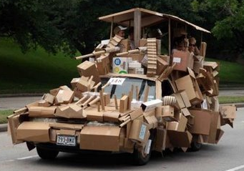
Stovepipe System
Traits
  Large gap between
  architectural documentation
  and implementation
  Over-budget project
  Failure to meet expectations
  Lack of usability (including installation), interoperability, maintainability
Causes
  Lack of common mechanisms for integrating components
  Multiple custom internal interfaces, each unique to its subsystem
  Insufficient metadata
  Tight internal coupling
  Lack of architectural vision
Fixes?

Slide 25
Stovepipe System
Traits
  Large gap between
  architectural documentation
  and implementation
  Over-budget project
  Failure to meet expectations
  Lack of usability (including installation), interoperability, maintainability
Causes
  Lack of common mechanisms for integrating components
  Multiple custom internal interfaces, each unique to its subsystem
  Insufficient metadata
  Tight internal coupling
  Lack of architectural vision
Fixes: abstract internal interfaces, with standard components and metadata for supporting component configuration and discovery

Slide 26
Architecture by Implication
Traits
  Lack of planning and specification
  Hidden risks caused by lack of scalability and domain knowledge and oversimplification, which emerge over course of project
  Ignorance of new technologies
  Absence of backup and contingency plans
Causes
  No risk management
  Overconfidence of managers, architects, and/or developers
  Reliance on previous experience, which may not apply
  Gaps in system engineering
Fixes?

Slide 27
Architecture by Implication
Traits
  Lack of planning and specification
  Hidden risks caused by lack of scalability and domain knowledge and oversimplification, which emerge over course of project
  Ignorance of new technologies
  Absence of backup and contingency plans
Causes
  No risk management
  Overconfidence of managers, architects, and/or developers
  Reliance on previous experience, which may not apply
  Gaps in system engineering
Fixes:
  Prioritizing development, use of architecture
  Use of viewpoints to test architecture

Slide 28
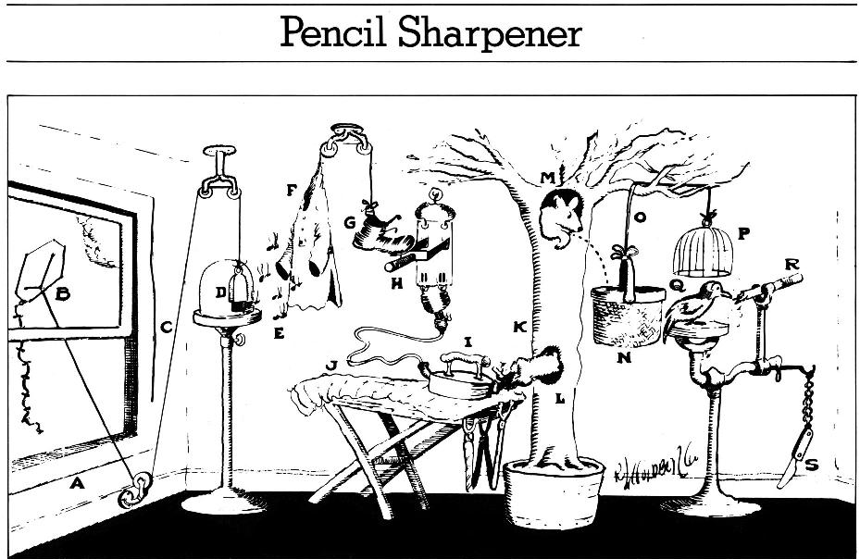
Design by Committee

Slide 29
Design by Committee
Traits
  Design documentation is overly complex, unreadable, incoherent, voluminous, and/or excessively defective
  Unstable requirements and/or design
  Interpretations of requirements and/or design conflict
  Committee meetings degenerate into unproductive bull sessions
  Environment is politically charged
  Prioritization of features is lacking
Causes
  No designated architect
  Ineffective development processes, including meetings
  Gold-plating, due to (e.g.) proprietary interests or desire to please everyone
Fixes?

Slide 30
Design by Committee
Traits
  Design documentation is overly complex, unreadable, incoherent, voluminous, and/or excessively defective
  Unstable requirements and/or design
  Interpretations of requirements and/or design conflict
  Committee meetings degenerate into unproductive bull sessions
  Environment is politically charged
  Prioritization of features is lacking
Causes
  No designated architect
  Ineffective development processes, including meetings
  Gold-plating, due to (e.g.) proprietary interests or desire to please everyone
Fixes:
  Reform the meeting process
  Assign explicit roles – e.g., owner, facilitator, architect. developers, testers, domain experts

Slide 31
Reinvent the Wheel
Traits
  Architectures and designs developed without thought for reuse
  Replication of COTS functions
Causes
  No communication or technology transfer between development projects
  Absence of an explicit architectural process that considers reuse and domain engineering
  Assumption of development from scratch
Fixes?

Slide 32
Reinvent the Wheel
Traits
  Architectures and designs developed without thought for reuse
  Replication of COTS functions
Causes
  No communication or technology transfer between development projects
  Absence of an explicit architectural process that considers reuse and domain engineering
  Assumption of development from scratch
Fixes:
  Prior investigation of architecture patterns and representative technologies before development
  Immature artists imitate. Mature artists steal. -- Lionel Trilling

Slide 33
Management Anti-Patterns (Summary)
Blowhard jamboree – allowing opinions of so-called industry experts to influence technology decisions.
Analysis paralysis – striving for perfection and completeness in analysis phase
Death by planning - creation of complex schedules that create downstream problems
Viewgraph engineering – use of viewgraphs, powerpoints, and documents rather than proper development tools to develop software
Difficult people - obstruction of development by people with hidden agendas
Intellectual violence - use of theories, technologies, and/or buzzwords to shut off dialogue by intimidation
Irrational management - Habitual indecisiveness, micromanagement, knee-jerk decision making, and so on

Slide 34
Management Anti-Patterns (Summary)
Smoke and mirrors – creating overly optimistic project plans based on best-case demonstrations of unrealized technologies
Analysis paralysis – striving for perfection and completeness in analysis phase
Project mismanagement – inattention to scheduling, detail; directionlessness
Throw it over the wall – mistakenly treating written guidelines as absolutes without confirming "firmness" of same with their authors
Fire drill – "Months of boredom followed by demands for immediate delivery."
Feuds – animosity between managers
Inappropriate use of e-mail - Use of e-mail for sensitive conversations, criticisms, most confrontational discussions, politically incorrect comments, and legally actionable statements

